Slide 1

What Makes The World Happy
A study of world happiness and the factors that cause it.
By
Charles Ryan Barrett & Ryan Bruggemann

Slide 2
Hypothesis For Happiness
Largest factors
Minor factors
Cascading factors

Slide 3
How Is Happiness Measured?
Happiness Score
GDP
Social Help/Welfare
Health
Freedom
Generosity
Perceived Corruption

Slide 4
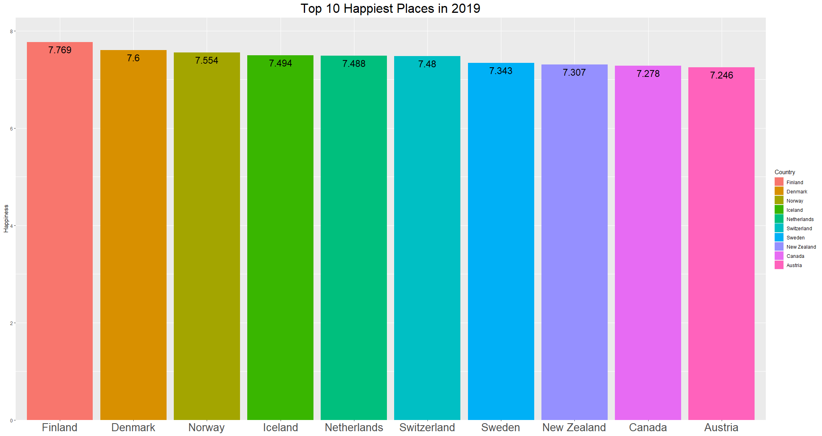

Slide 5
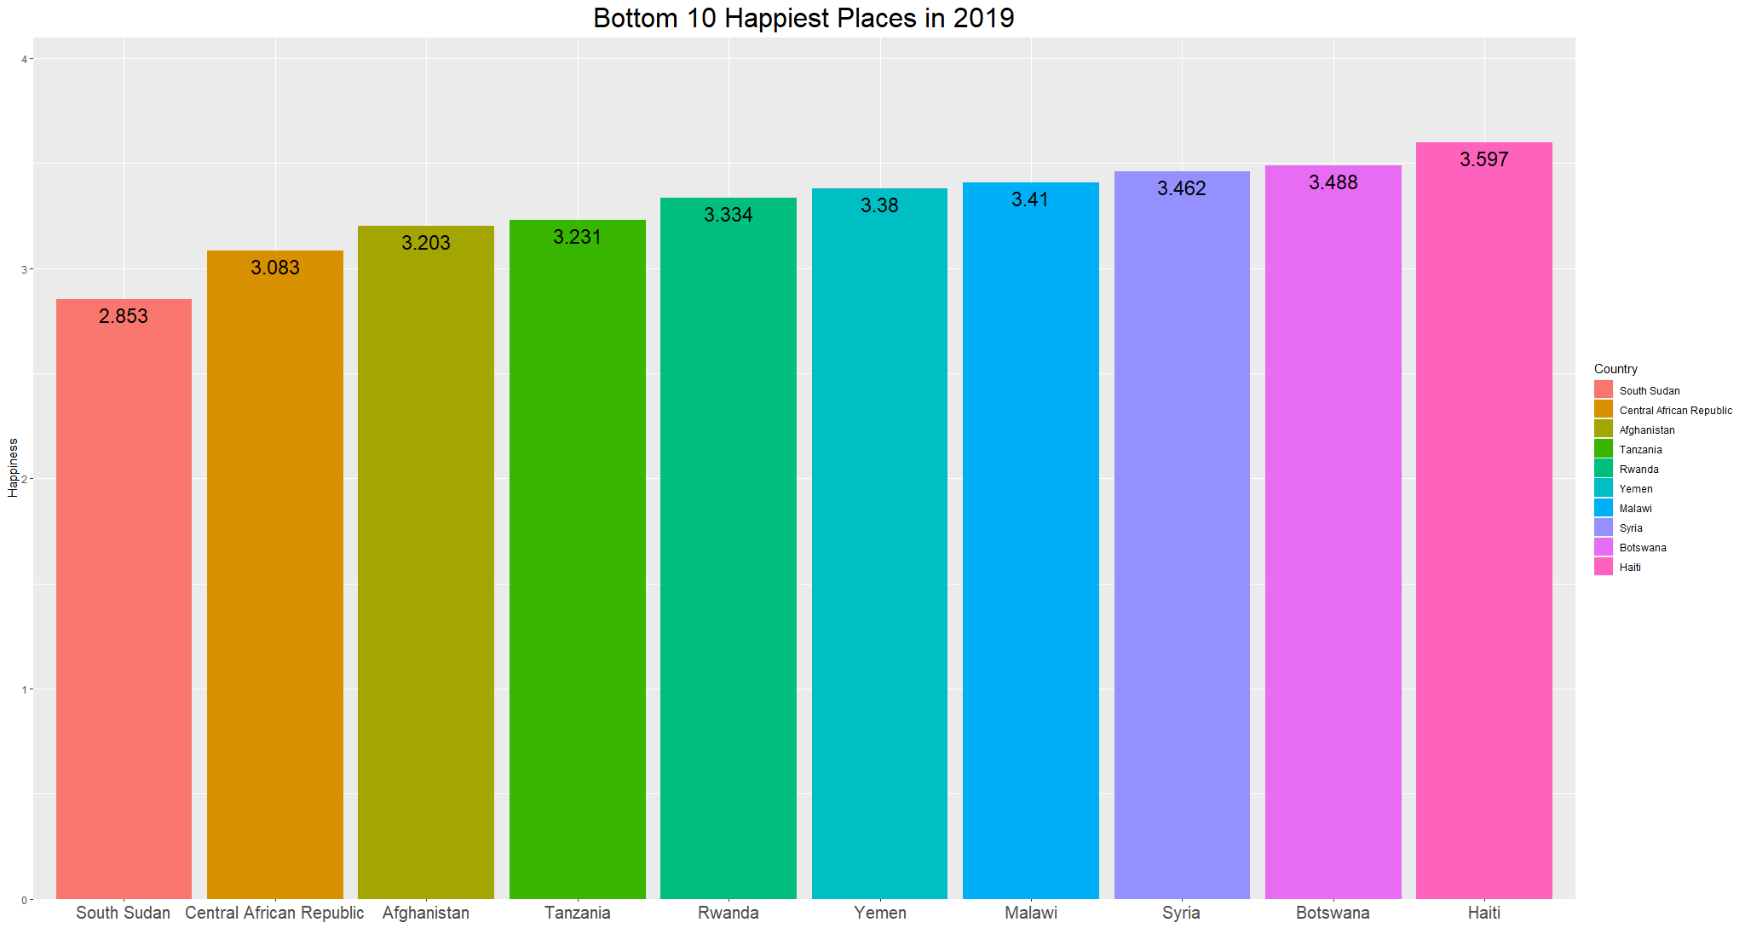

Slide 6
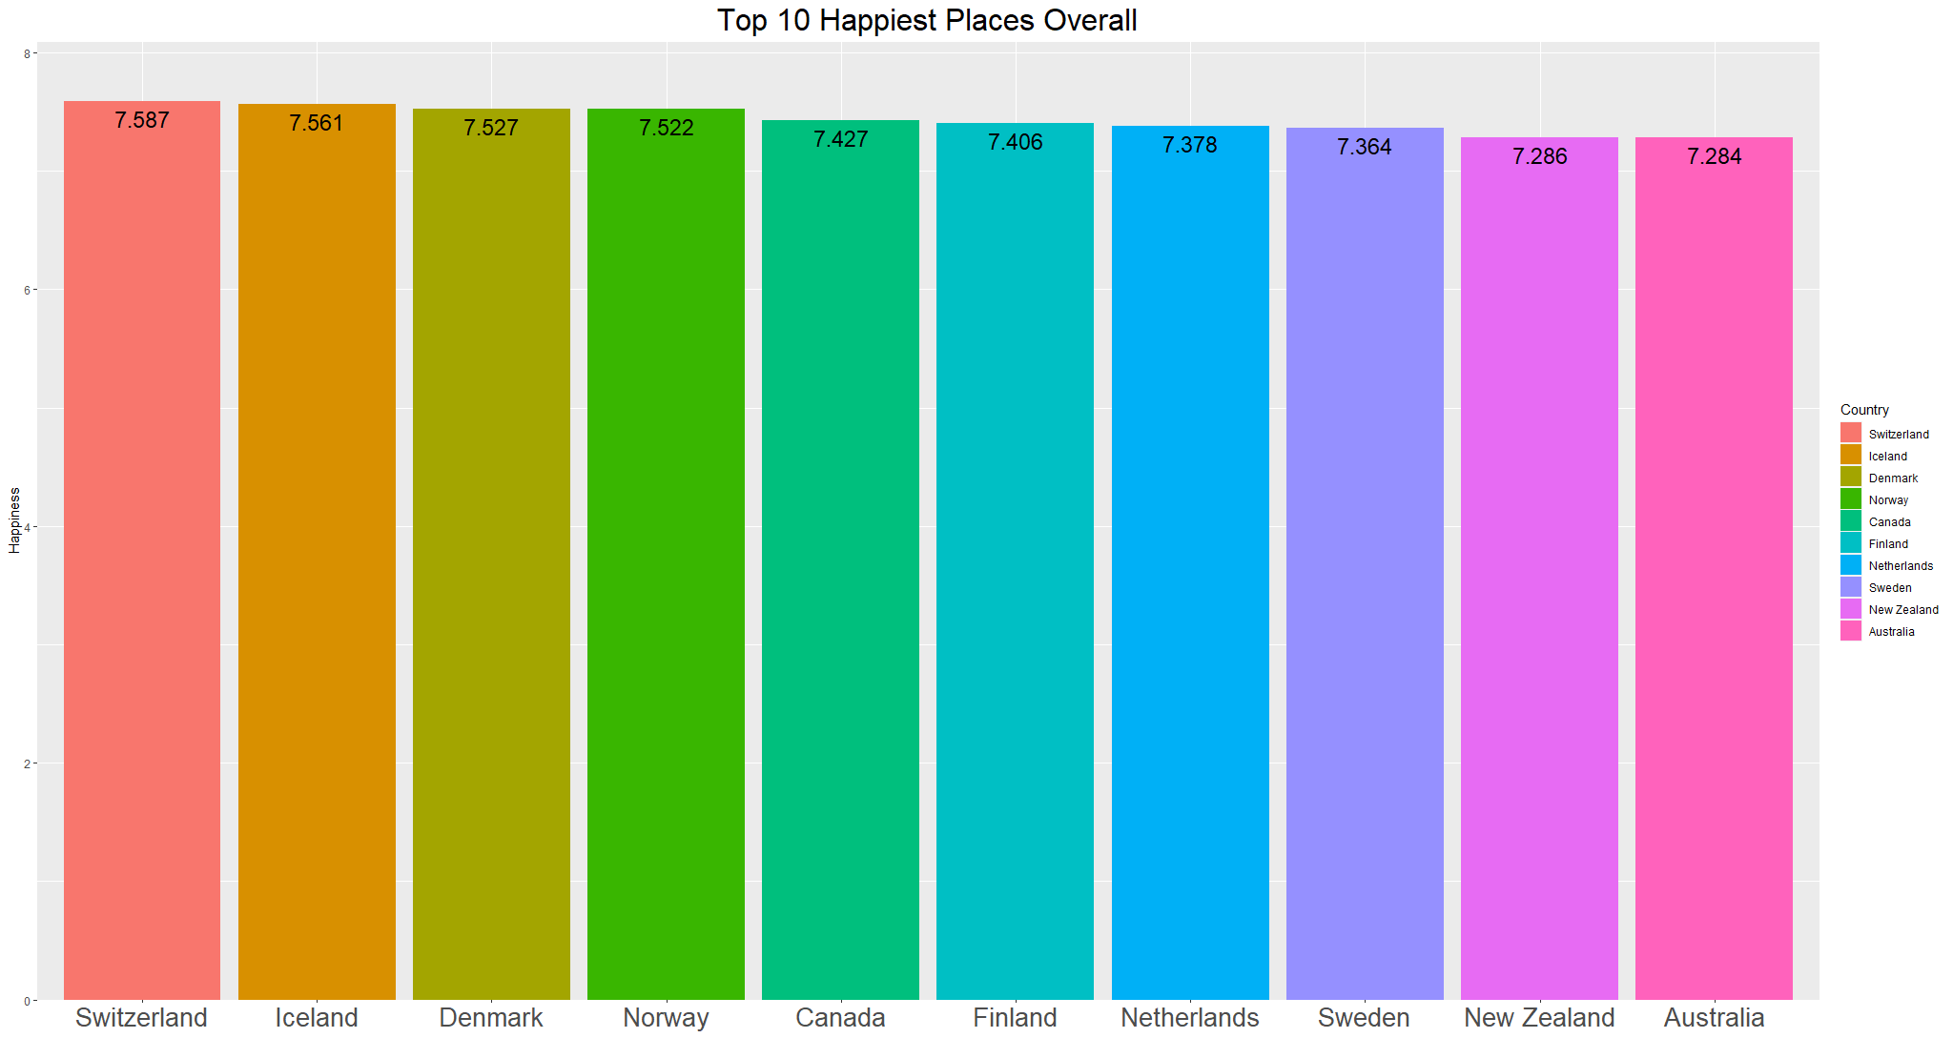

Slide 7
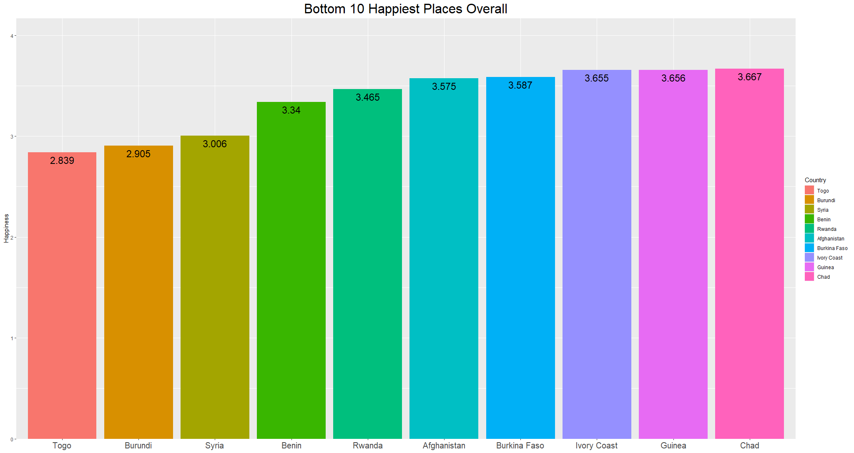

Slide 8
The Path Of The Two Tens
Methods to find changes
How they shifted
What factors determined the changes?

Slide 9
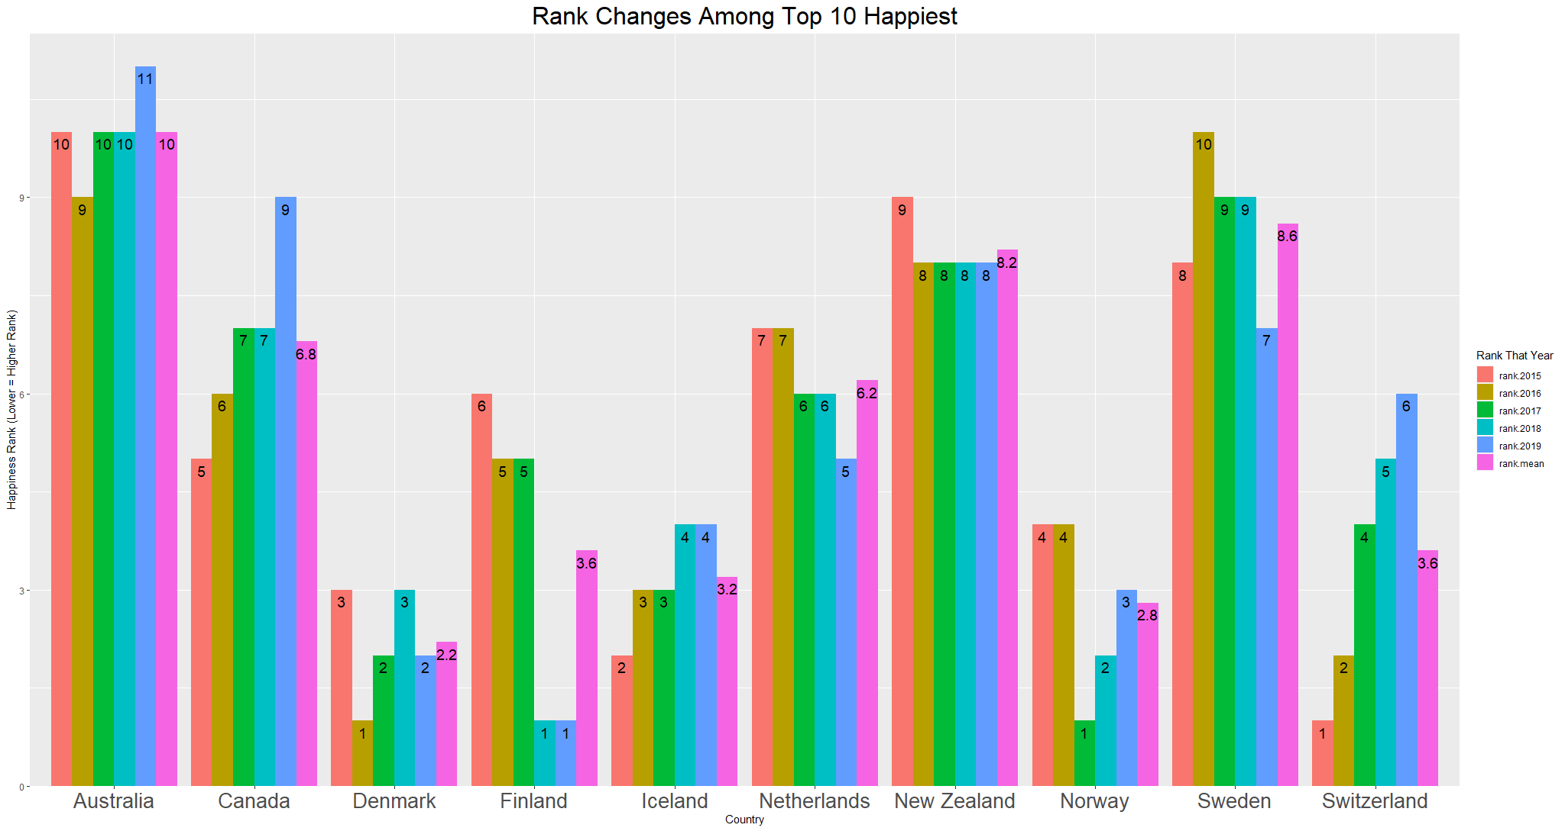

Slide 10
Changes Within The Top Ten
Most Stable: New Zealand
Highest Average Rank: Denmark
Lowest Average Rank: Australia

Slide 11
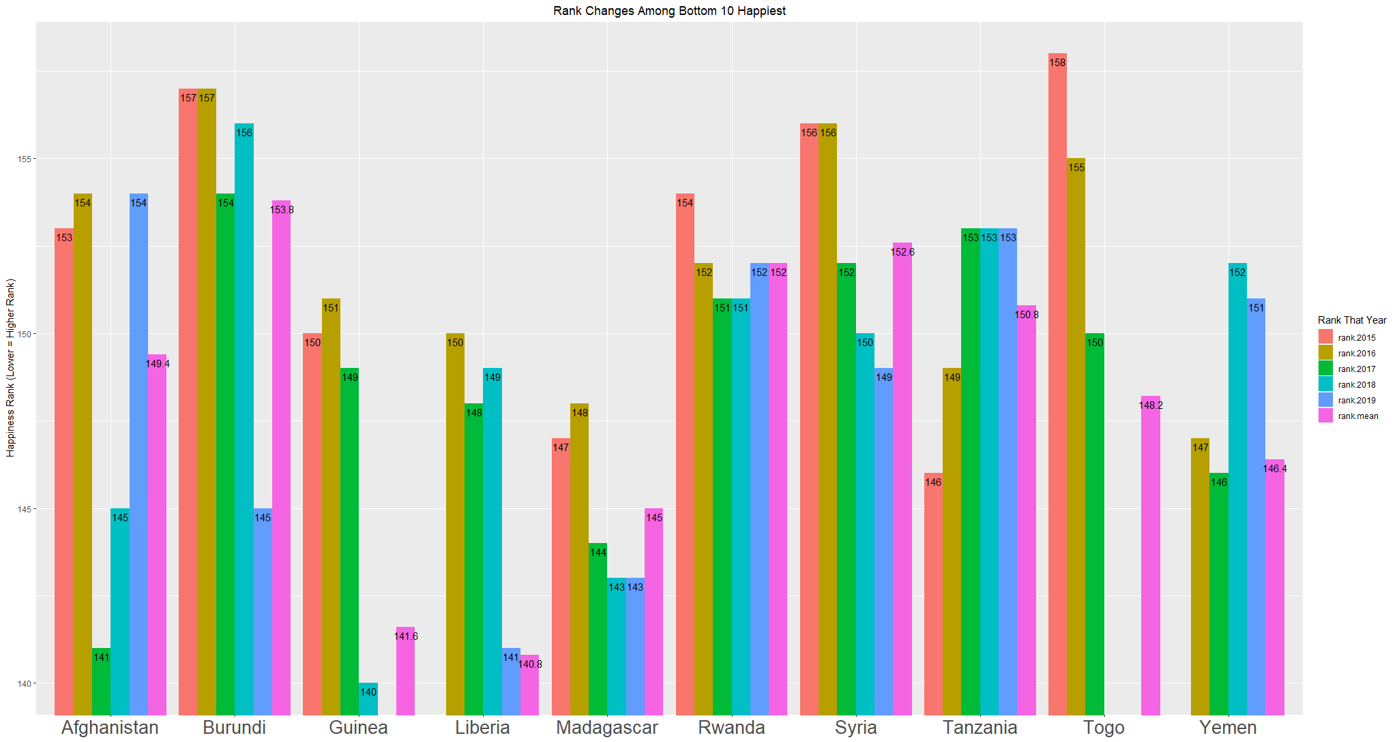
Notes:
*Note, many of the bottom happiest are more unstable. Therefore, for certain ones there are missing years of data that are affecting the overall score

Slide 12
Changes Within The Bottom Ten
Most Stable: Rwanda
Highest Average Rank: Liberia
Lowest Average Rank: Burundi

Slide 13

Largest Changes In Rank 2015-2019
Benin improved the most (Rank 155 to Rank 102)
Venezuela had the largest drop (Rank 23 to Rank 108)
How? Why?
Notes:
Benin went up 53 ranks.
Venezuela went down 85 ranks.

Slide 14
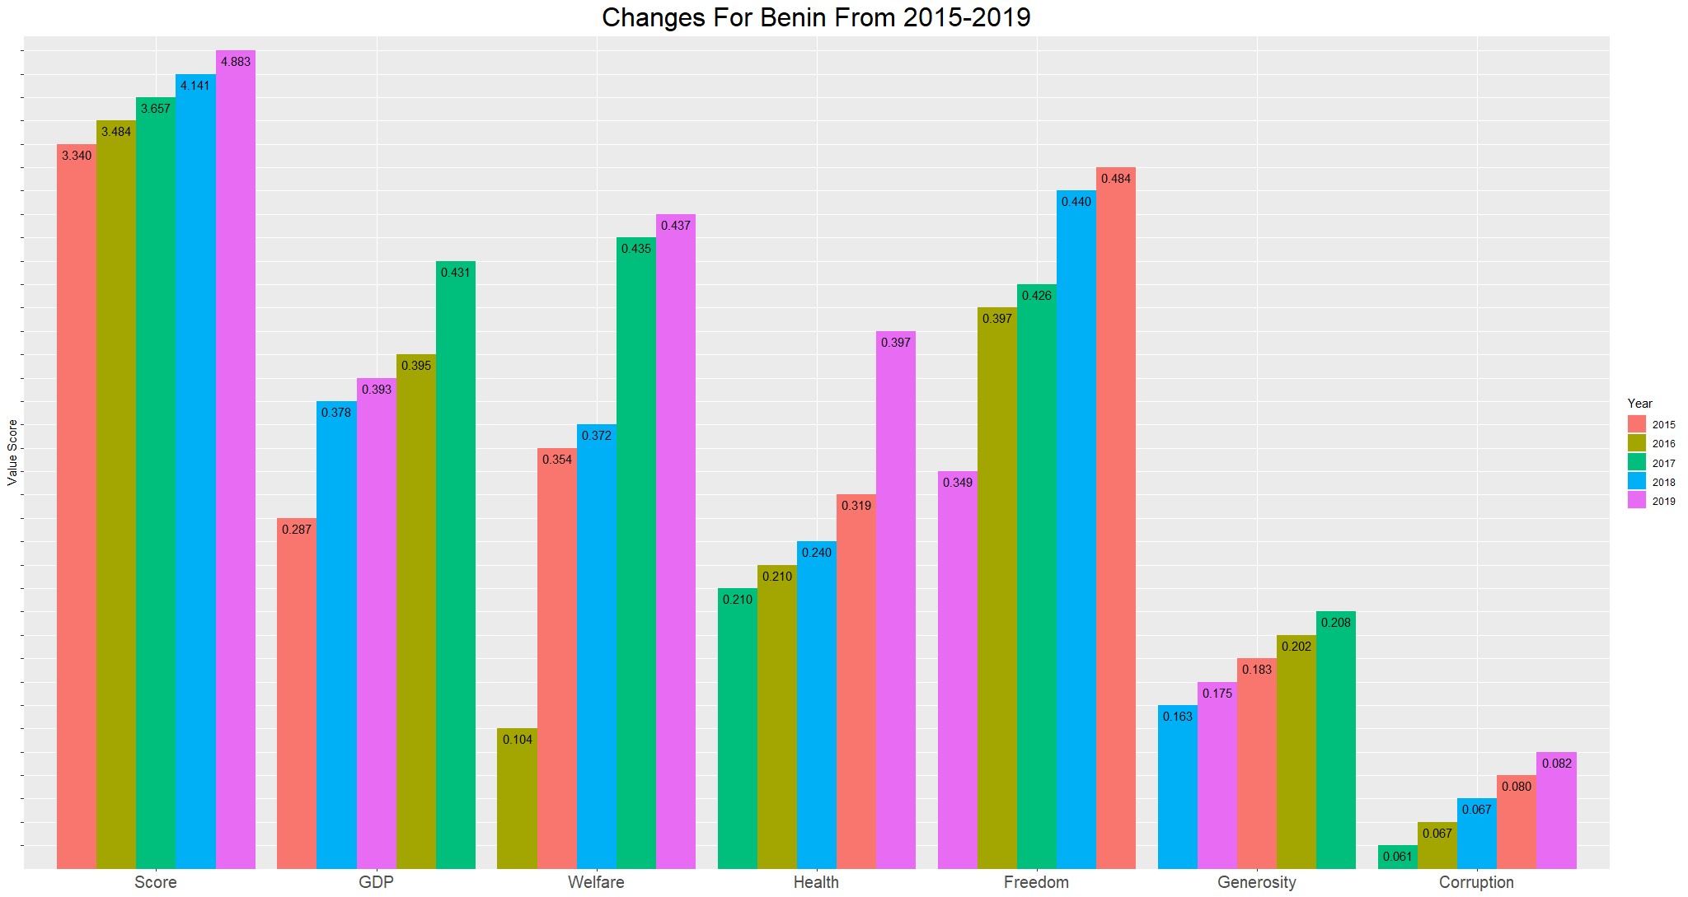

Slide 15
Changes For Benin
Significant increase in Welfare
Significant increase in Health
Freedom was rising then fell

Slide 16
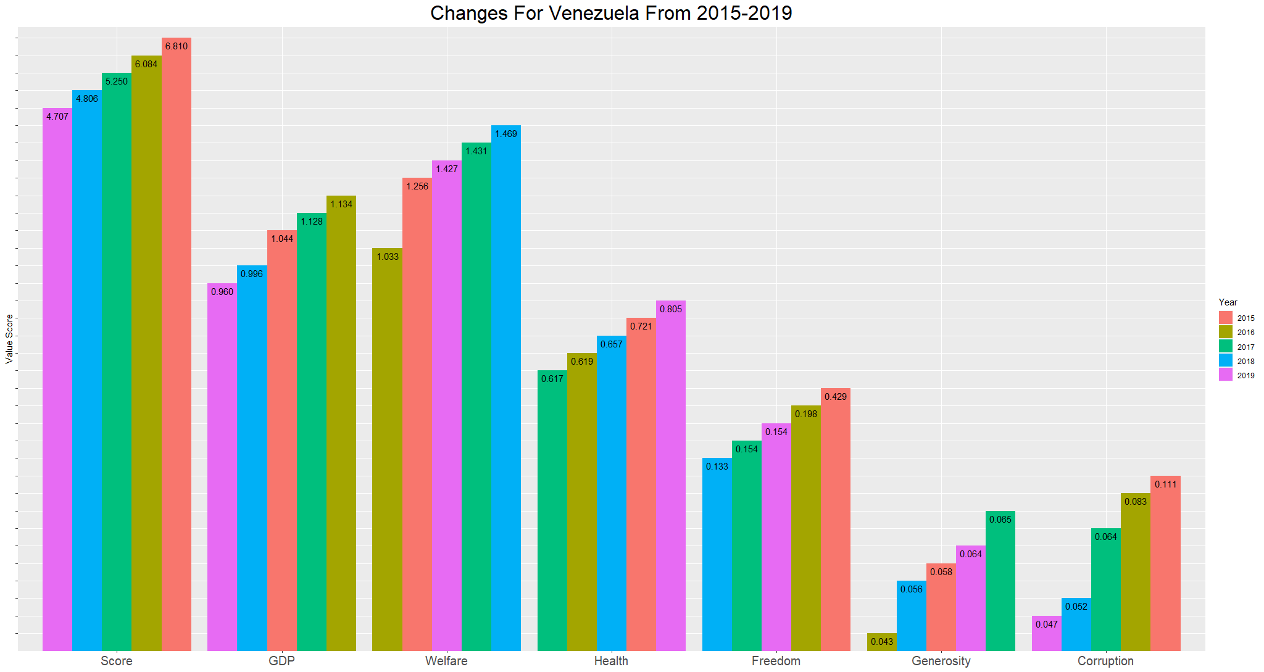

Slide 17
Changes For Venezuela
Corruption significantly down
GDP down

Slide 18

Finding The Factors
Coincidence or contributor?
How?

Slide 19
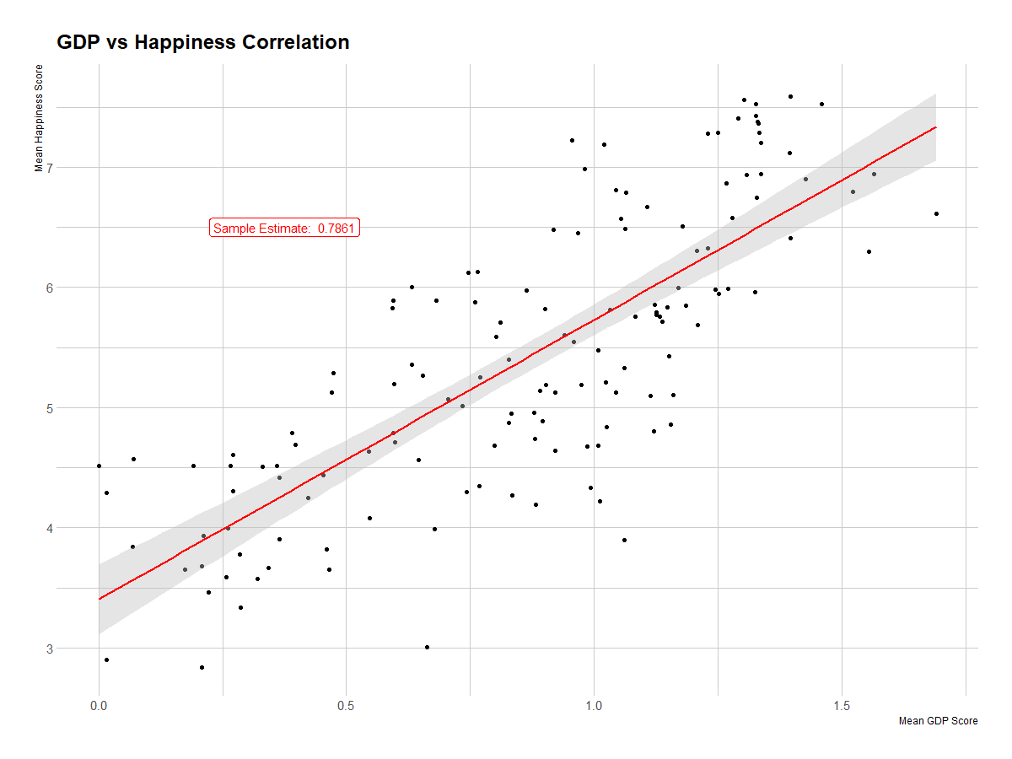

Slide 20
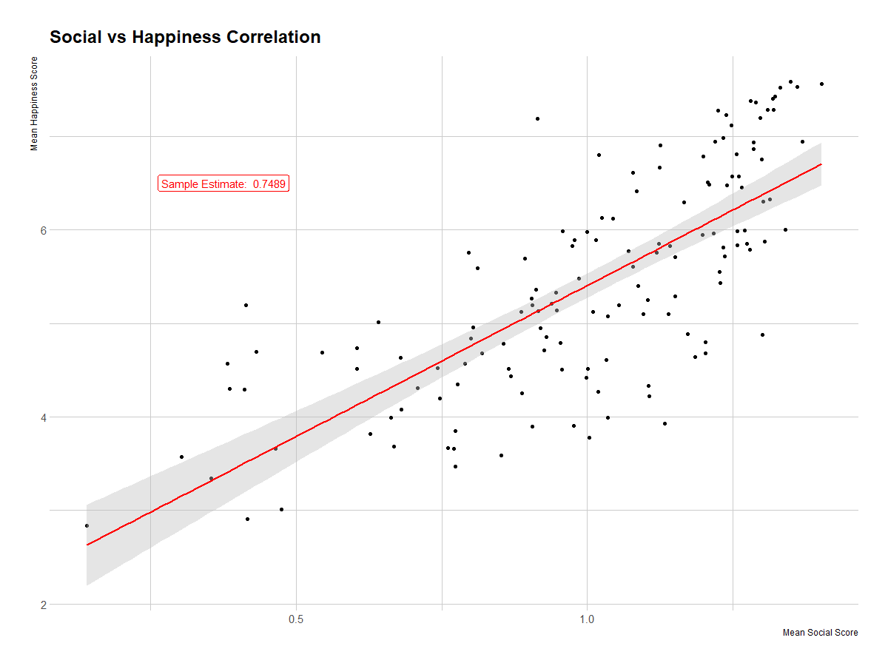

Slide 21
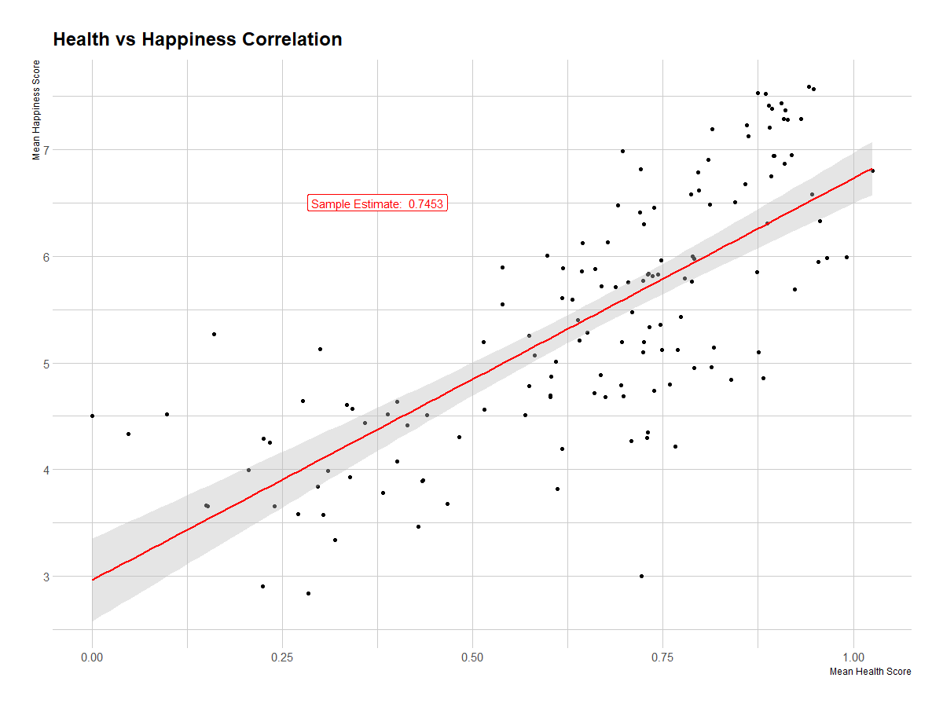

Slide 22
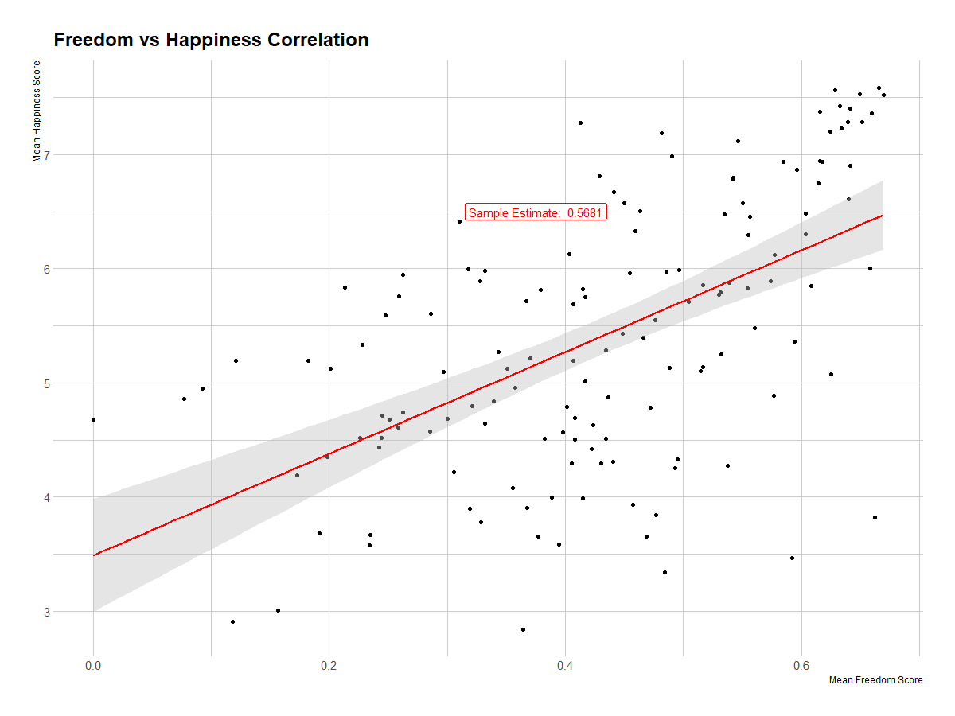

Slide 23
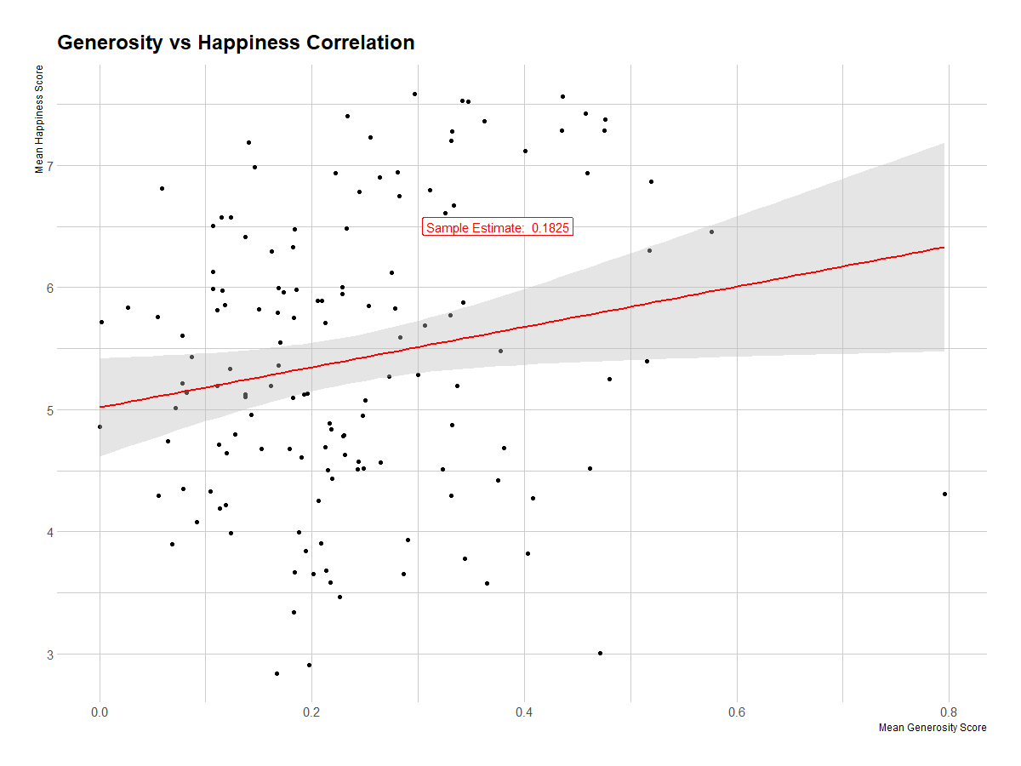

Slide 24
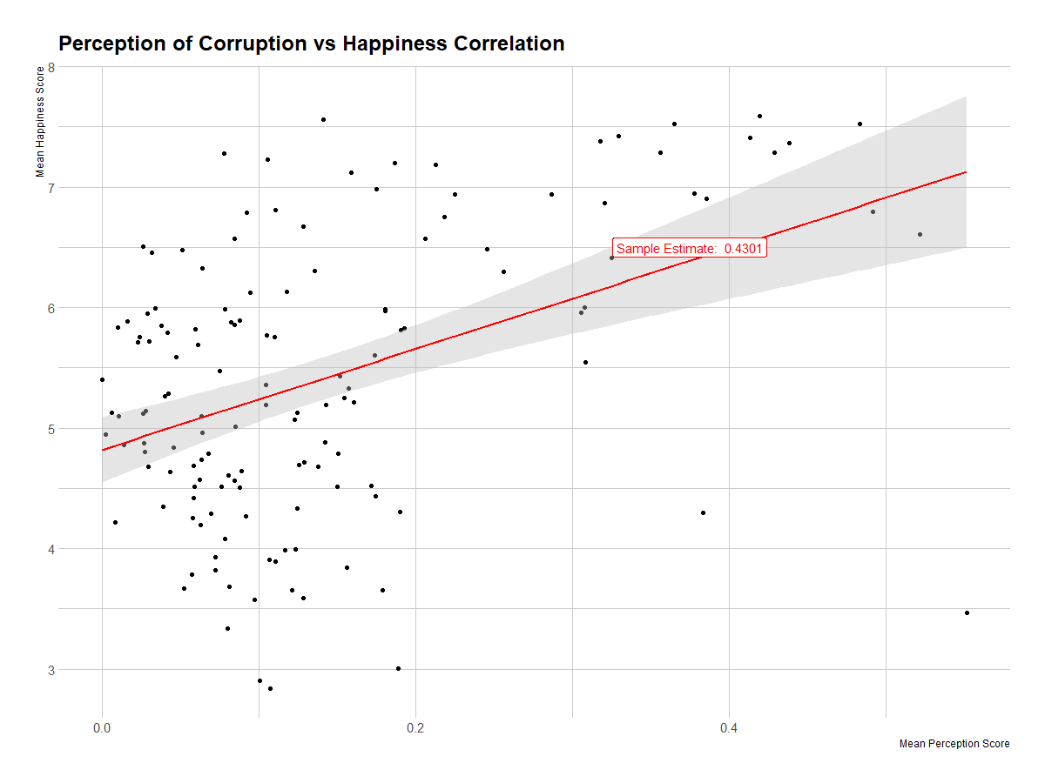

Slide 25

The Results
#1 GDP (0.7861)
#2 Social Assistance/Welfare (0.7489)
#3 Health (0.7453)
#4 Freedom (0.5681)
#5 Corruption (0.4301)
#6 Generosity (0.1825)

Slide 26
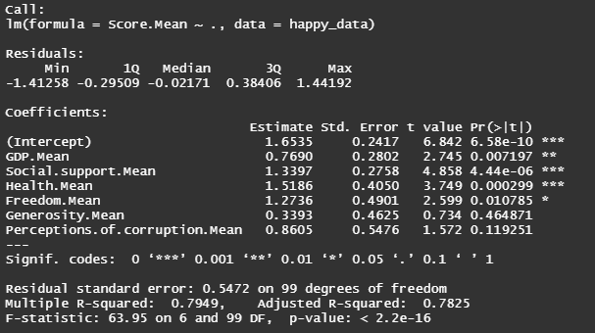
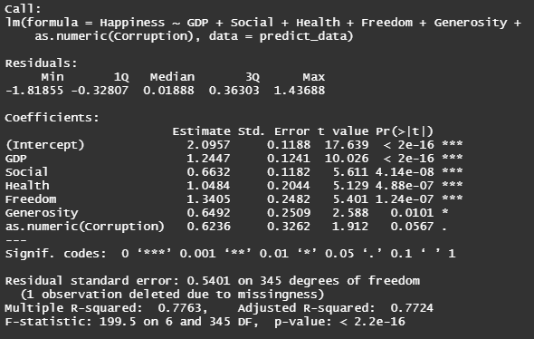
Linear Regression
Using All Variable Data
Using Mean Variable Data

Slide 27
Findings
GDP, Social Assistance, Health and Freedom Scores have highest influence on happiness of a country
Generosity has low influence
Corruption can be ignored when making a prediction

